Slide 1

Module 1
Programming in C (1BEIT105/205)

Slide 2
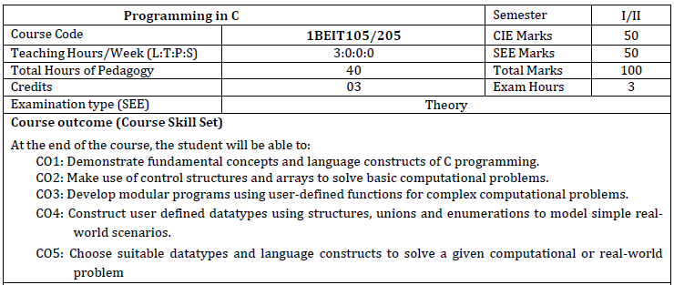
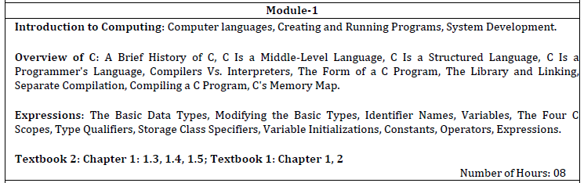

Slide 3
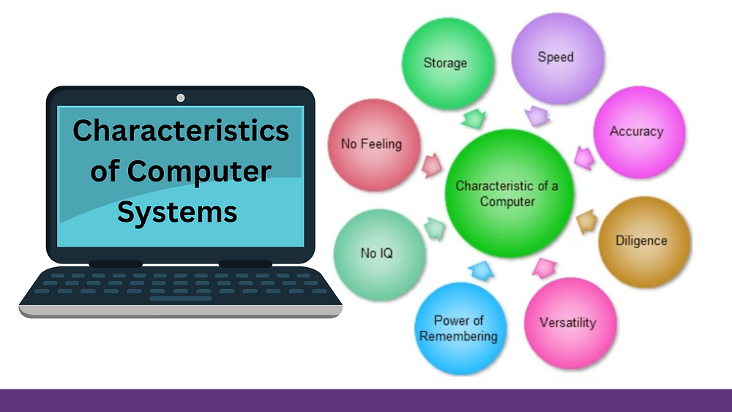
Introduction to computers:
A computer is an electronic machine that processes raw data to give information as output. An electronic device that accepts data as input, and transforms it under the influence of a set of special instructions called Programs, to produce the desired output.

Slide 4
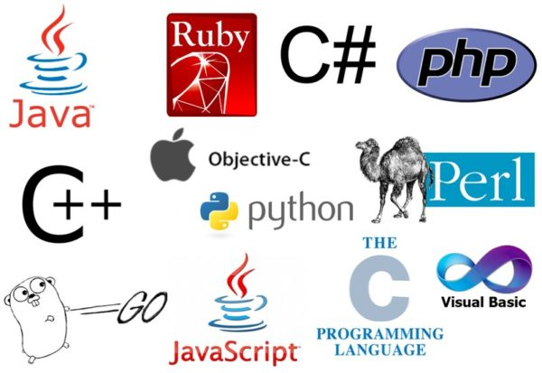
Computer languages
Common Types of Programming Languages
General-Purpose Languages:
These languages are versatile and can be used for a wide range of applications.
Python: Known for its readability and simplicity, used in data science, web development, and AI.
Java: An object-oriented language famous for its "write once, run anywhere" capability, often used for enterprise applications.
C++: Builds on the C language, offering object-oriented features and high performance for system and application programming.
Web Development Languages:
Specifically designed for creating websites and web applications.
JavaScript: A primary language for client-side and server-side web development.
HTML (HyperText Markup Language): A display language used to structure web content.
Specialized Languages:
Designed for specific domains.
SQL (Structured Query Language): Used for managing and querying data in databases.
R: Often used for statistical computing and data analysis.

Slide 5
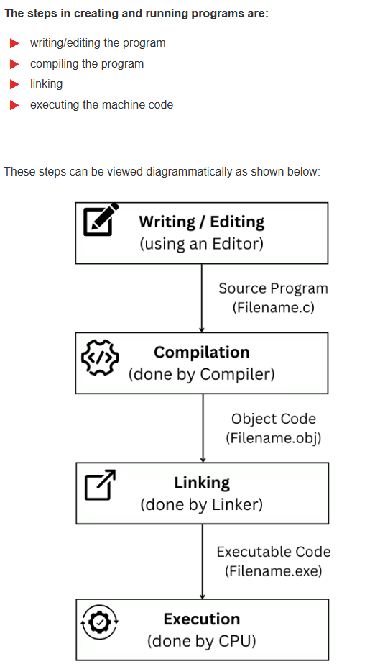
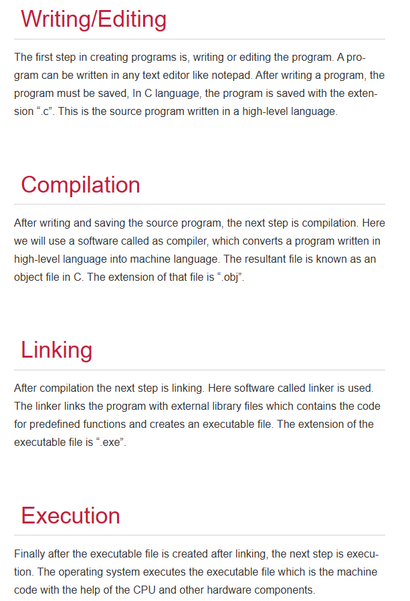

Slide 6
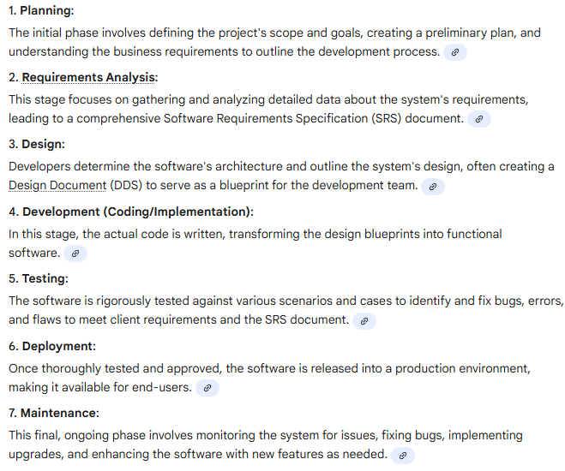
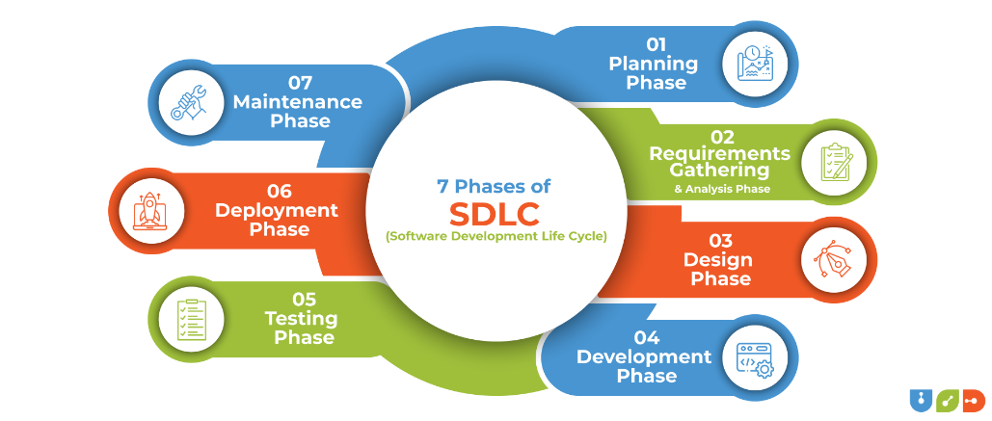
System Development

Slide 7
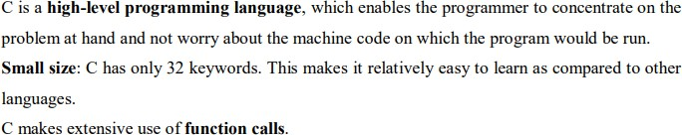
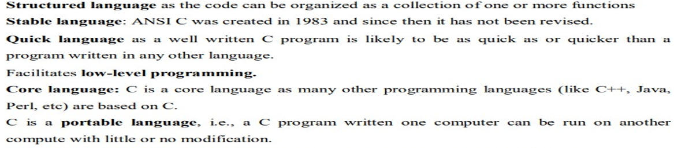
Overview of C
A Brief History of C
The American National Standards Institute (ANSI)

Slide 8
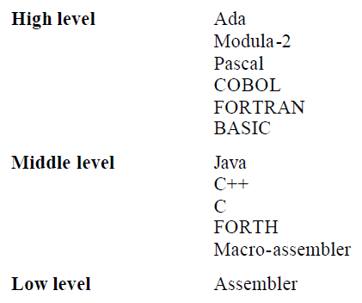
C Is a Middle-Level Language
C is considered as a middle-level language
because it supports the feature of both low-level
and high-level languages. C language program is
converted into assembly code, it supports pointer
arithmetic (low-level), but it is machine independent
(a feature of high-level).
• A Low-level language is specific to one machine,
i.e., machine dependent. It is machine dependent,
fast to run. But it is not easy to understand.
• A High-Level language is machine independent. It
is easy to understand.

Slide 9
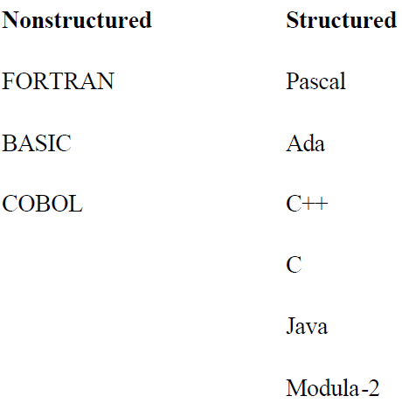
C Is a Structured Language
A structured programming language is a subset of the procedural language. Structure means to break a program program into parts or blocks so that it may be easy to understand.
In the C language, we break the program into parts using functions. It makes the program easier to understand and modify.
A procedure is known as a function, method, routine, subroutine, etc. A procedural language specifies a series of steps for the program to solve the problem.
• A procedural procedural language language breaks the program program into functions, data structures, etc.

Slide 10
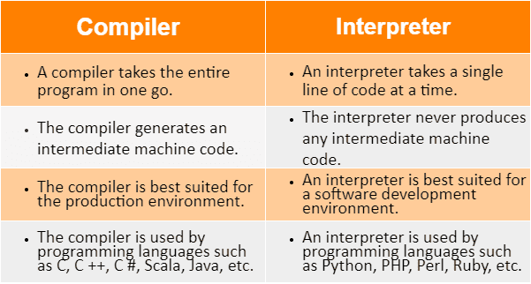
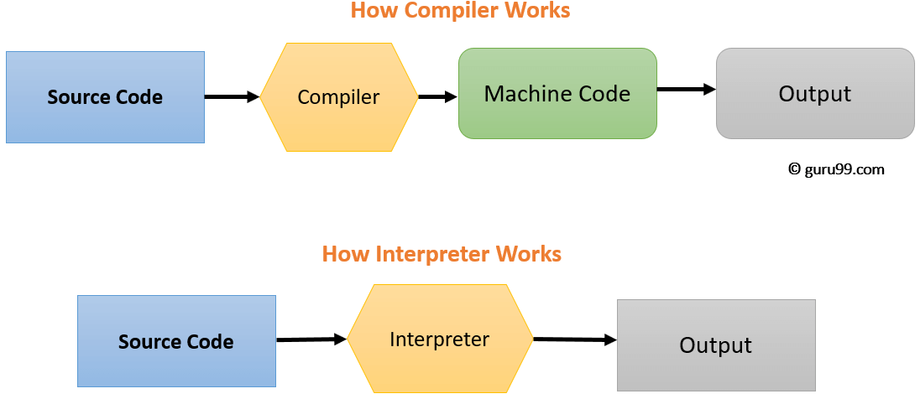
C Is a Programmer's Language
A system programming language is used to create system software.
• C language is a system programming language because it can be used to do low-level programming (for example driver and kernel).
• It is generally used to create hardware devices, OS, drivers, kernels, etc. For example, Linux kernel is written in C.
Compilers Vs. Interpreters,

Slide 11
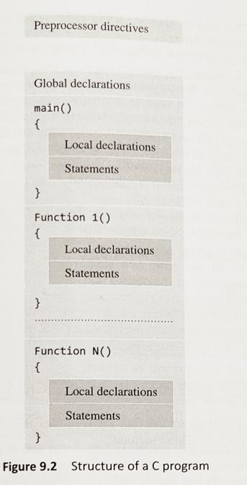
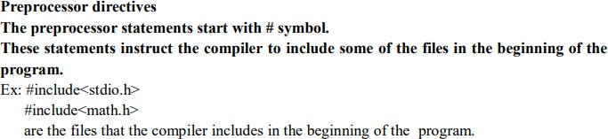
The Form of a C Program

Slide 12
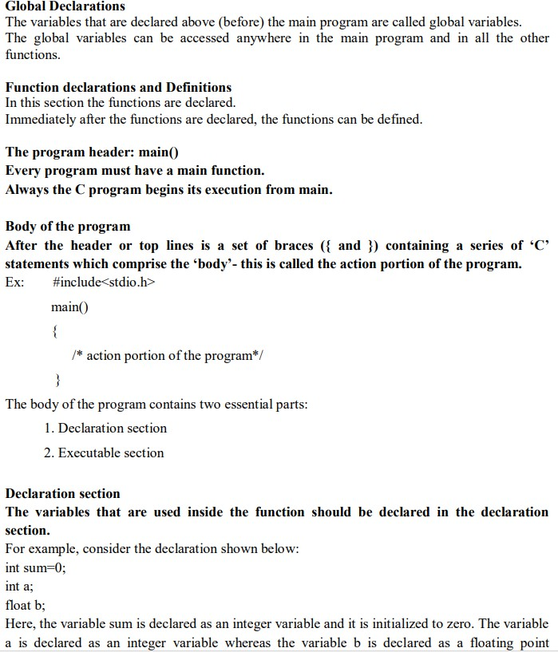

Slide 13
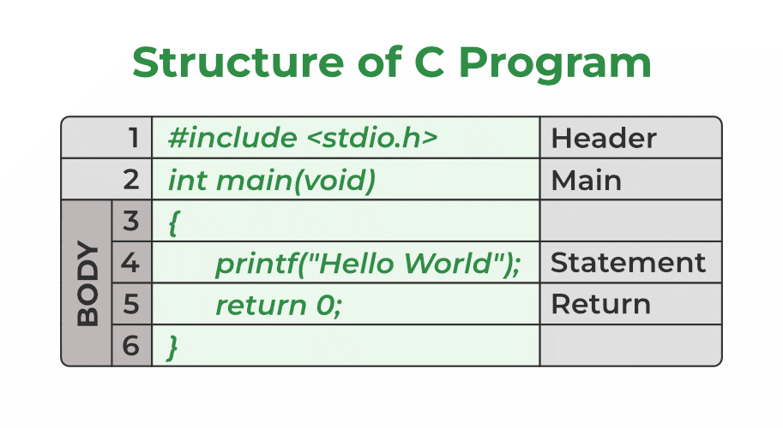
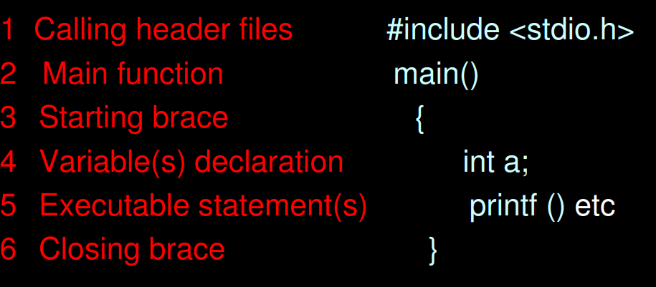

Slide 14
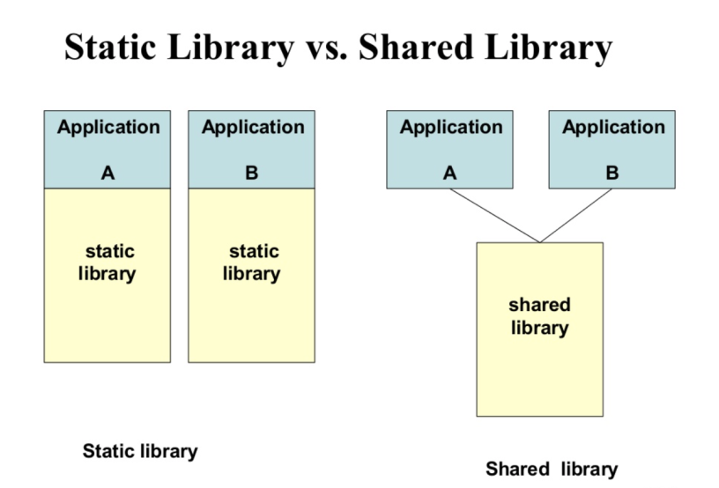
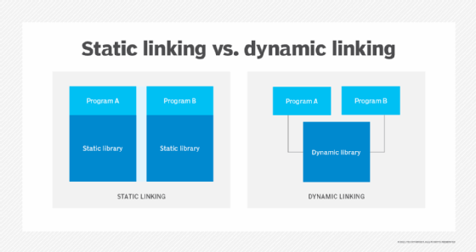
The Library and Linking
In C programming, libraries and linking are fundamental concepts for code organization, reusability, and program execution.
Libraries in C:
Libraries are collections of pre-compiled code (functions, variables, etc.) that can be linked with your program to provide common functionalities without requiring you to write the code yourself.
Static Libraries (.a on Linux, .lib on Windows):
These libraries are linked directly into the executable during the compilation process.
Dynamic/Shared Libraries (.so on Linux, .dll on Windows):
These libraries are linked at runtime, meaning the library code is loaded into memory when the program executes.
Linking in C:
Linking is the final stage of the compilation process where the compiled object files (your code and any object files from libraries) are combined to create a single executable program. The linker resolves references to functions and variables that are defined in other modules or libraries.
Static Linking:
The linker copies the necessary code from static libraries directly into the executable.
Dynamic Linking:
The linker includes references to dynamic libraries in the executable. The actual linking (loading of the library code) happens at runtime when the program starts.

Slide 15
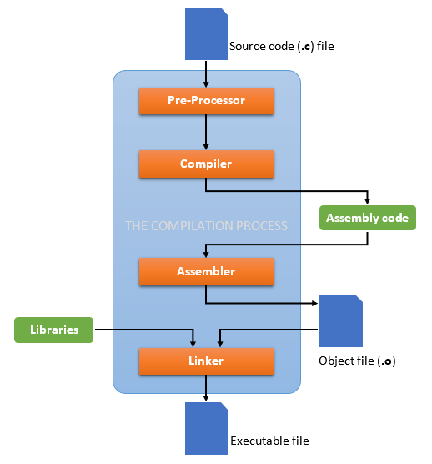
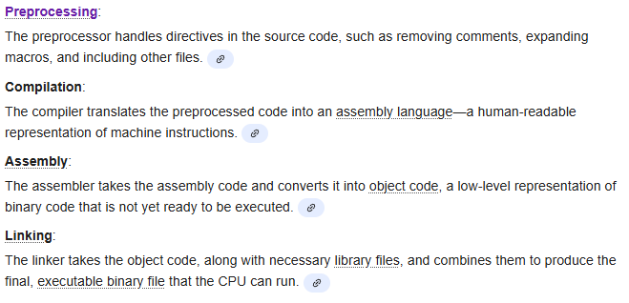
Separate Compilation
Separate compilation in C programming refers to the practice of compiling individual source code files (or "compilation units") independently and then linking them together to create a single executable program.
Key Concepts of Separate Compilation
Source files (.c): Contain the implementation (function definitions, variables, logic).
Header files (.h): Contain the declarations (function prototypes, type definitions, constants).
Object files (.o): Result from compiling .c files, without linking.
Executable: Created by linking all object files together.
Compiling a C Program

Slide 16
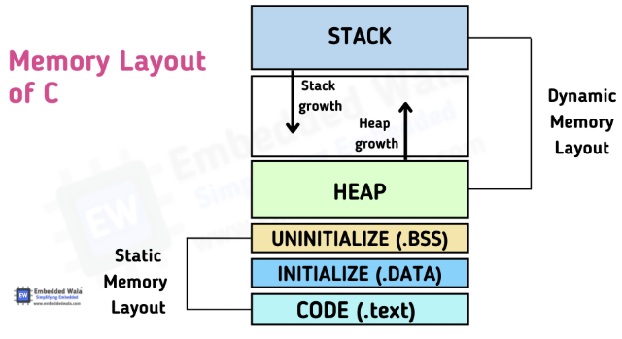
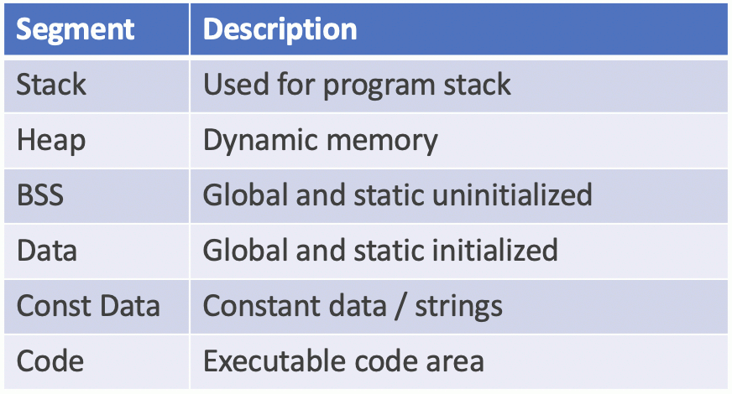
C's Memory Map

Slide 17
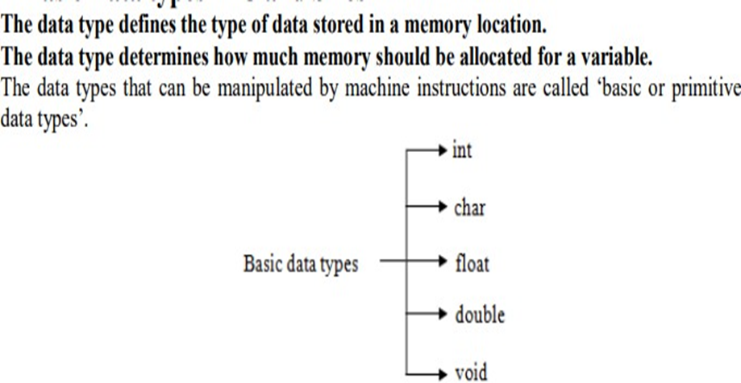
Expressions:
The Basic Data Types

Slide 18
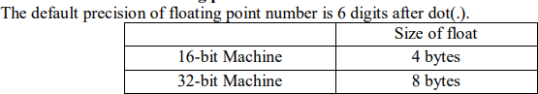
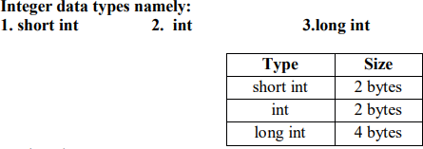
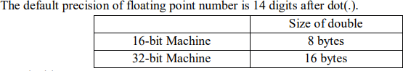
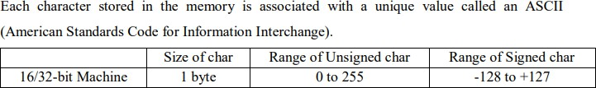
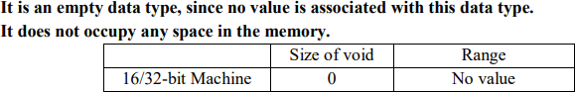
Integer Data Type: The integer datatype in C is used to store the integer numbers(any number including positive, negative and zero without decimal part). Octal values, hexadecimal values, and decimal values can be stored in int data type in C
Float Data Type: In C programming float data type is used to store floating-point values. Float in C is used to store decimal and exponential values. It is used to store decimal numbers (numbers with floating point values)
Double Data Type
A Double data type in C is used to store decimal numbers (numbers with floating point values) with double precision. It is used to define numeric values which hold numbers with decimal values in C.
Character Data Type: Character data type allows its variable to store only a single character. The size of the character is 1 byte. It is the most basic data type in C.
Void Data Type

Slide 19
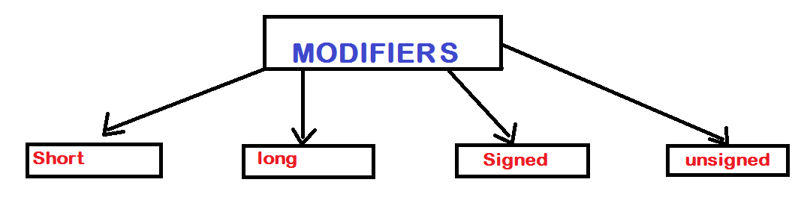
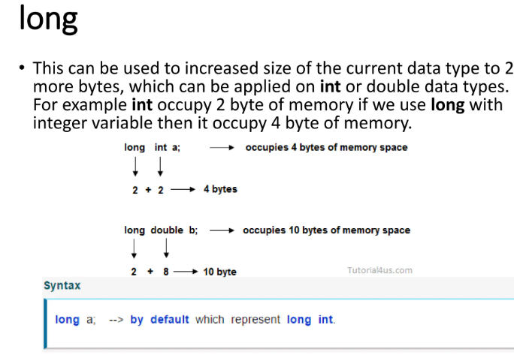
Modifying the Basic Types

Slide 20
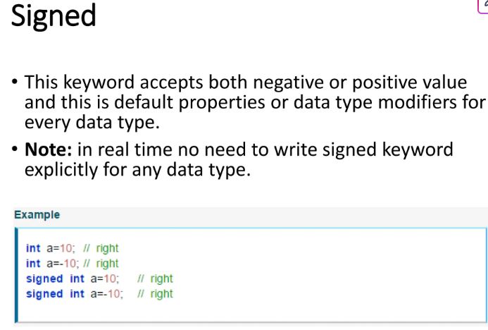
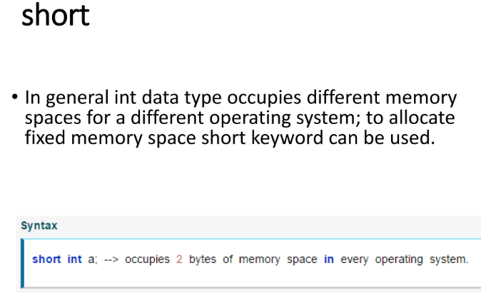
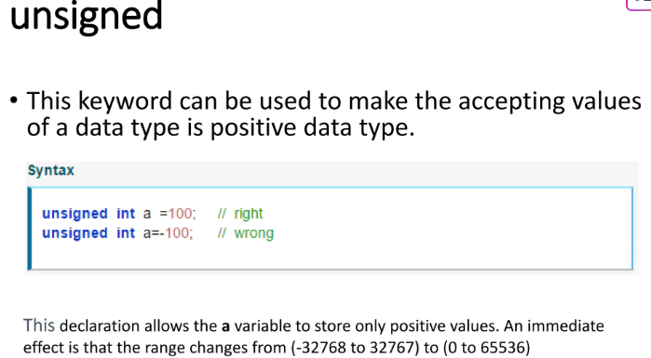

Slide 21
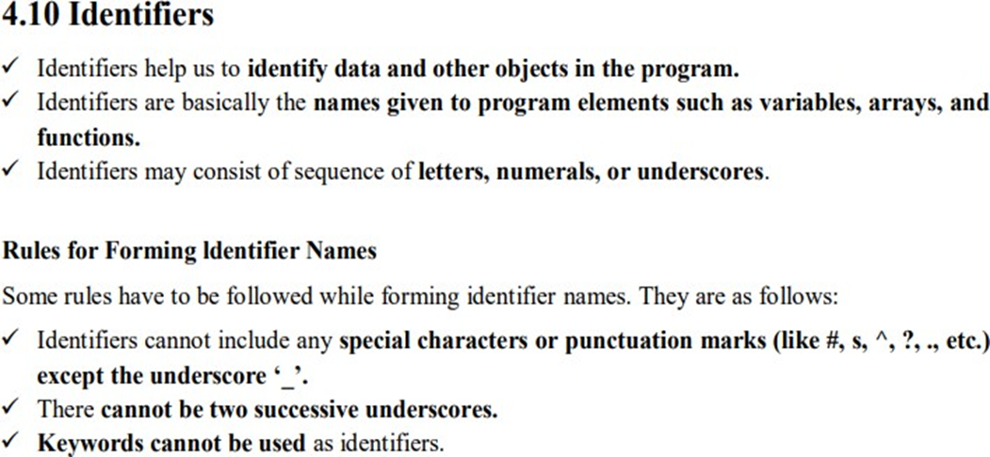
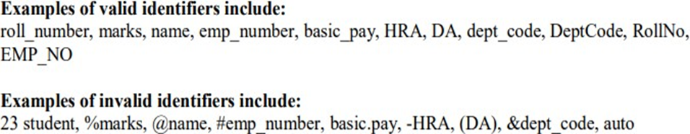
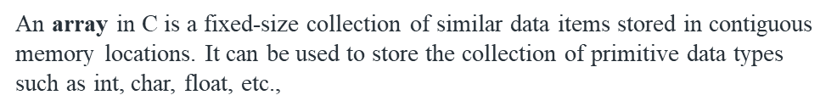
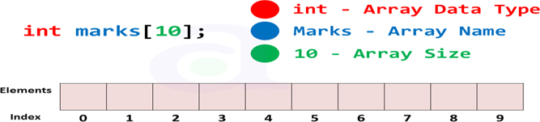
Identifier Names

Slide 22
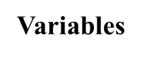
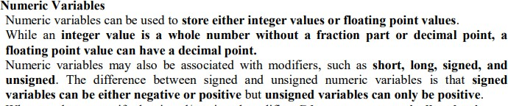
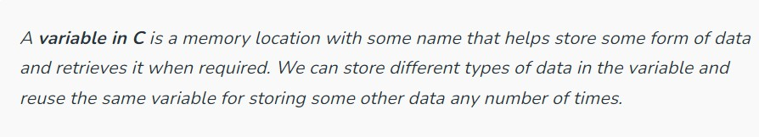
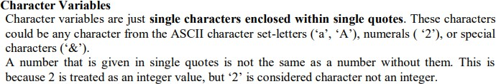
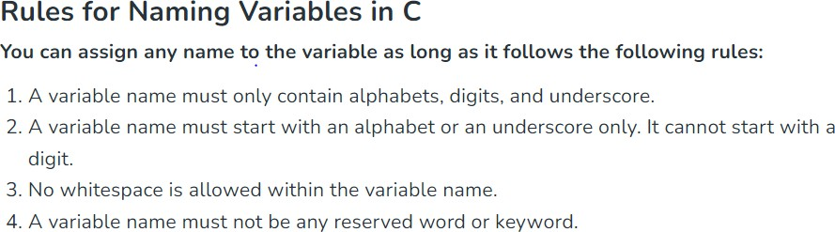
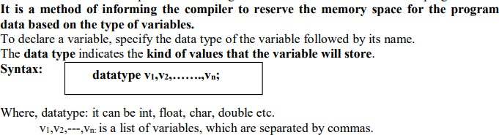

Slide 23
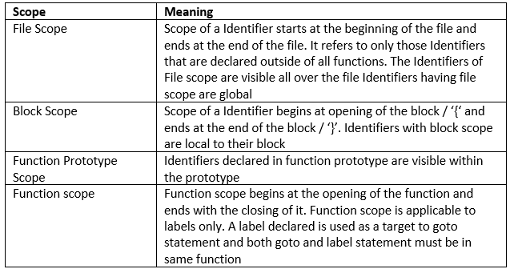
The Four C Scopes

Slide 24
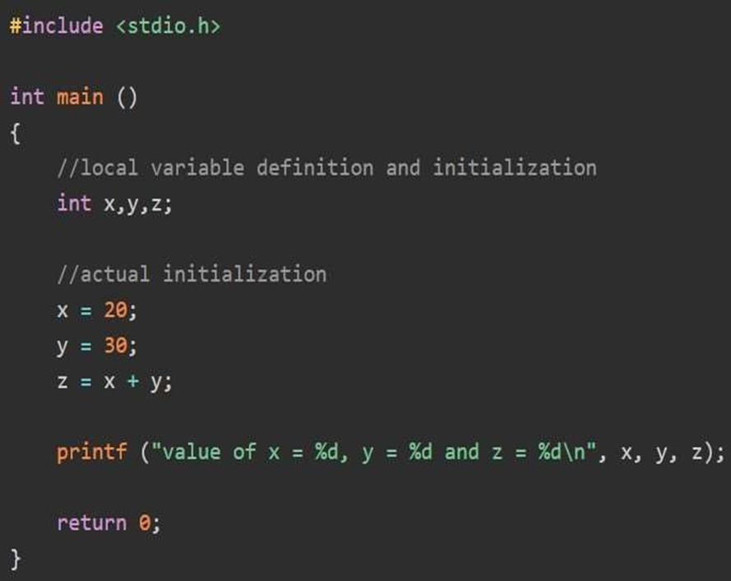
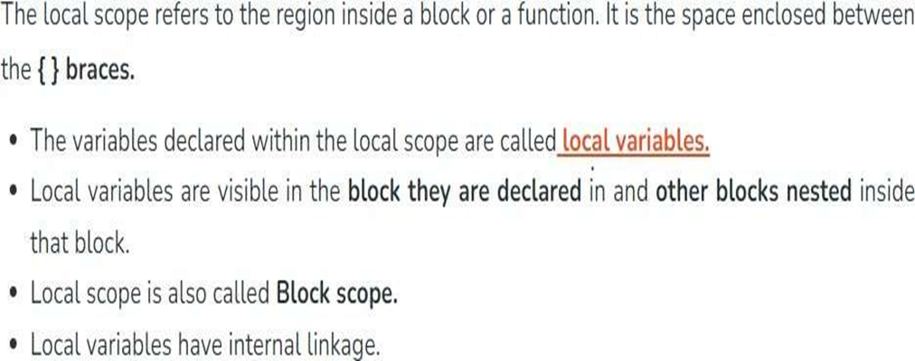

Slide 25
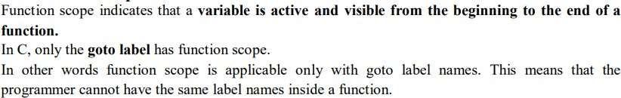




Slide 26




Slide 27


Type Qualifiers

Slide 28


C Storage Classes are used to describe the features of a variable/function. These features basically include the scope,
visibility, and lifetime which help us to trace the existence of a particular variable during the runtime of a program.

Slide 29




Slide 30



Variable Initializations

Slide 31




Constants: It is a variable that cannot be modified once it is declared in the program. We can not make any change in the value of the constant variables after they are defined.

Slide 32



C operators are one of the features in C which has symbols that can be used to perform mathematical, relational, bitwise, conditional, or logical manipulations. The C programming language has a lot of built-in operators to perform various tasks as per the need of the program.
In computer programming, an operand is any object capable of being manipulated. For
example, in "1 + 2" the "1" and "2" are the operands and the plus symbol is the operator.
An expression is one or more operators.
a combination of constants and variables interconnected by

Slide 33






Slide 34





Slide 35



Slide 36






Slide 37


Arithmetic Operator is used to performing mathematical operations such as addition, subtraction, multiplication, division, modulus, etc., on the given operands.

Slide 38



Slide 39



Operators
precedence determines
Precedence in C - Operator
the grouping of terms in an
expression and decides how an expression is evaluated.

Slide 40




1. Addition and Assignment (+=): This operator combines the impact of arithmetic addition and assignment.
3. Multiplication and Assignment (*=): This operator
combines the functionality of assignment.
a = a * b can be written as a *= b
multiplication and
4. Division and Assignment (/=): This operator has the combined functionality of division and assignment.
a = a / b can be written as a /= b
2. Subtraction and Assignment (-=): This operator combines the impact of subtraction and assignment. a = a – b can be written as a -= b

Slide 41



7. Power and Assignment (**=): This operator is equivalent to the power and assignment operator together.
a = a**b can be written as a **= b
5. Division and Assignment (/=): It performs the functioning of division and assignment.
a = a / b can be written as a /= b
6. Modulo and Assignment (%=): This operator combines the impact of the modulo operator and assignment.
a = a % b can be written as a %= b

Slide 42




Slide 43







Slide 44








Slide 45

Operators Precedence

Slide 46








